Slide 1


Sap ABAP on Hana &
s/4hana trainings
Anubhav Oberoy

Slide 2

INTRODUCTION

Slide 3
Agenda – Day 6
Introduction of CDS(Core Data & Service )
Concept of CDS View
Describing Standard CDS View
Understanding Concept of Code to Data Paradigm
Creating CDS Entities
--Break--
CDS Associations
Describing CDS View on View
Making Virtual Data Model’s (VDM )
Basic/Interface View
Composite View
Consumption View
Describing CDS Angle
Create your own OData Service on top of CDS Views

Slide 4

Introduction to Core Data & Services
CDS stands for Core Data Services. This is the new programming paradigm within new SAP environment specifically S/4HANA systems. So CDS views are the new programming design concepts which can achieve Code-to-Data paradigm which actually means Code push down into the database for processing.

Slide 5
Core Data & Services at Glance
1
4
Semantically Rich Data-Models
Domain specific languages (DDL, QL, DCL)
Declarative, close to conceptual thinking
Common Basis for Domain-Specific Frameworks e.g. UI, Analytics, Odata, BW,…
@AnalyticsDetails.aggregationBehaviour: SUM
2
5
CDS is completely based on SQL
Any ‘Standard SQL’ features directly available like joins, unions, build-in functions, …
Built-in Functions and Code Pushdown
Table Functions for Breakout Scenarios
Rich Set of Built-in SQL Functions
3
6
Fully Compatible with Any DB
Generated and managed SQL Views
Modern Open SQL
Extensible
On model level thru extensions
On meta-model level thru annotations

Slide 6
Concept of CDS
Can I develop CDS views if my Company is not on HANA?
Yes, Provided your ABAP system is above NW 7.4 SP6 +. You may not get the full potential as you may get when you are on HANA.
Are CDS views same as HANA Calculation Views?
No. HANA Calc view created in HANA Directly, But CDS views are created in ABAP. When you activate it generate Runtime object which is a HANA View inside of HANA.
Which system do I code cds views.
ABAP system only using ADT
Which is the best way and best practice to implement the CDS views? Are there some guidelines on CDS views for S/4HANA?
You can get good performance with CDS views, there are guidelines which we can use like VDM
I have heard about HANA CDS views also, are these same?
No. ABAP CDS and HANA CDS are one concept but 2 flavor. HANA CDS is used in companies who buys HANA only, they don’t have ABAP system. https://www.youtube.com/watch?v=rTsAg_OGh-A
Notes:
The sole purpose of an R/3 system is to provide a suite of tightly integrated, large-scale business applications. R/3 comes prepackaged with the core business applications needed by most large corporations. These applications coexist in one homogenous environment. They are designed from the ground up to run using a single database and one (very large) set of tables.
Presentation: It is usually installed on a user's workstation. When started, the presentation server displays the R/3 menus within a window. This window is commonly known as the SAPGUI, or the user interface (or simply, the interface).
Basis : Basis is like an operating system for R/3. It sits between the ABAP/4 code and the computer's operating system. SAP likes to call it middleware because it sits in the middle, between ABAP/4 and the operating system. ABAP/4 cannot run directly on an operating system. It requires a set of programs (collectively called Basis) to load, interpret, and buffer its input and output. Basis provides the runtime environment for ABAP/4 programs.
Database: The database server is a set of executables that accept database requests from the application server. These requests are passed on to the RDBMS (Relation Database Management System). The RDBMS sends the data back to the database server, which then passes the information back to the application server. The application server in turn passes that information to your ABAP/4 program.

Slide 7
Concept of CDS
If I am not from ABAP Background, do I need to learn ABAP to code CDS Views?
From here, CDS is completely new syntax.
Can I also create new DB Table using CDS, or is it only for Views?
Yes, indeed if you learn ABAP on Cloud, perhaps this is the only way to create table in ABAP on Cloud System.
Can we update data also from CDS views or is it only View data.
No. But when this concept is combined with frameworks like BOPF and RAP. Here CDS will work like template/data structure/BO to tell the framework what kind of data to work.
Can Fiori App Call CDS view directly
No. FIORI ONLY AND ONLY TALKS TO ODATA
Can BO Reporting tool consume CDS views?
Yes, even SAP Analytics Cloud.
What is VDM, we hear this term a lot?
Virtual Data Modeling, This is a gold standard to build views in SAP S/4HANA.
Notes:
The sole purpose of an R/3 system is to provide a suite of tightly integrated, large-scale business applications. R/3 comes prepackaged with the core business applications needed by most large corporations. These applications coexist in one homogenous environment. They are designed from the ground up to run using a single database and one (very large) set of tables.
Presentation: It is usually installed on a user's workstation. When started, the presentation server displays the R/3 menus within a window. This window is commonly known as the SAPGUI, or the user interface (or simply, the interface).
Basis : Basis is like an operating system for R/3. It sits between the ABAP/4 code and the computer's operating system. SAP likes to call it middleware because it sits in the middle, between ABAP/4 and the operating system. ABAP/4 cannot run directly on an operating system. It requires a set of programs (collectively called Basis) to load, interpret, and buffer its input and output. Basis provides the runtime environment for ABAP/4 programs.
Database: The database server is a set of executables that accept database requests from the application server. These requests are passed on to the RDBMS (Relation Database Management System). The RDBMS sends the data back to the database server, which then passes the information back to the application server. The application server in turn passes that information to your ABAP/4 program.

Slide 8
Concept of CDS
Can we pass parameters to CDS, is there any way I can pass SELECT-OPTIONS also
We can pass parameter, we cant code SELECT-OPTION directly
Can I call SQL Script code in CDS, Or can I call AMDP in CDS..
Yes, we have starring NW 7.5 a new option which called CDS table function
How do we secure Data using CDS views
CDS DCL concept
Can I extend a SAP Delivered CDS view?
Yes, we have CDS Extension concept
Where can I find the list of All the SAP Delivered CDS views in S/4HANA.
https://api.sap.com/themes/CDSViews
I hear a term called CDS Entity, SAP says that this will overwrite CDS views. Is it true?
Yes.
Notes:
The sole purpose of an R/3 system is to provide a suite of tightly integrated, large-scale business applications. R/3 comes prepackaged with the core business applications needed by most large corporations. These applications coexist in one homogenous environment. They are designed from the ground up to run using a single database and one (very large) set of tables.
Presentation: It is usually installed on a user's workstation. When started, the presentation server displays the R/3 menus within a window. This window is commonly known as the SAPGUI, or the user interface (or simply, the interface).
Basis : Basis is like an operating system for R/3. It sits between the ABAP/4 code and the computer's operating system. SAP likes to call it middleware because it sits in the middle, between ABAP/4 and the operating system. ABAP/4 cannot run directly on an operating system. It requires a set of programs (collectively called Basis) to load, interpret, and buffer its input and output. Basis provides the runtime environment for ABAP/4 programs.
Database: The database server is a set of executables that accept database requests from the application server. These requests are passed on to the RDBMS (Relation Database Management System). The RDBMS sends the data back to the database server, which then passes the information back to the application server. The application server in turn passes that information to your ABAP/4 program.

Slide 9

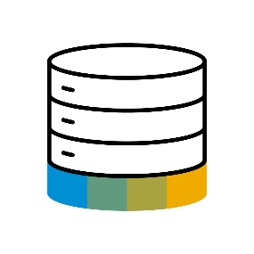
Paradigm Changes in Application Programming
Data-to-Code Intensive computations in APPLICATION layer
Application Programming Models
Classic Approach
Data Centric Approach
Database
Code-to-Data Intensive computations in DATABASE layer

Slide 10
A Family of Domain Specific Language
functions
functions
DDL
DCL
Data modelling and retrieval on a higher semantic level
Extends native SQL leads to higher productivity
Define authorizations for DDL views
Modelled and declarative approach
Integrates with classic authorization concepts
Data Definition Language
Query Language
Data Control Language
functions
QL
Consume CDS entities via Open SQL in ABAP
Fully transparent SQL extensions

Slide 11
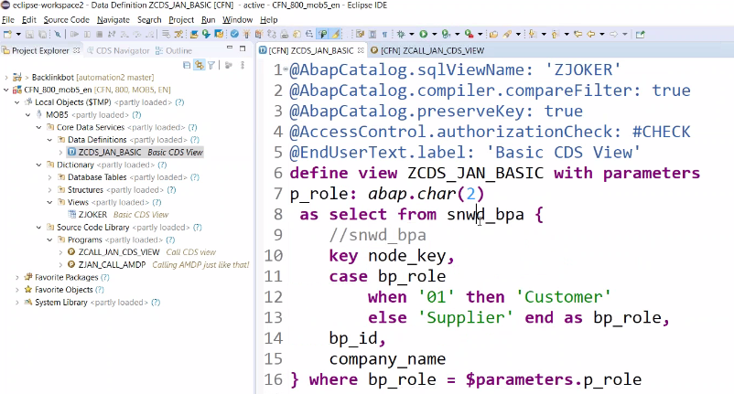
Creating CDS View

Slide 12
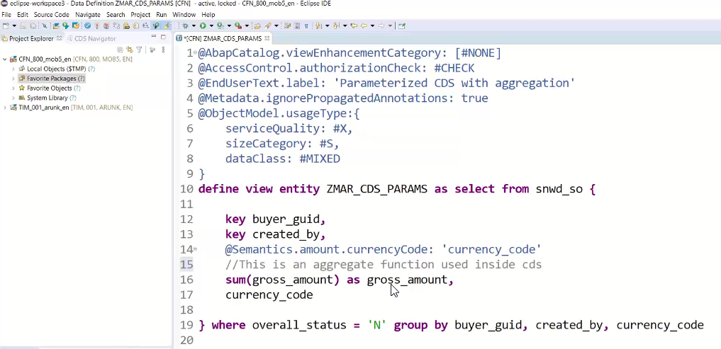
Core Data & Service Entities
A CDS entity has a specified number of columns, defined at the time of entity creation, but can have any number of rows. Database entities also typically have meta-data associated with them; the meta-data might include constraints on the entity or on the values within particular columns. SAP HANA Extended Application Services (SAP HANA XS) enables you to create a database entity as a design-time file in the repository. All repository files including your entity definition can be transported to other SAP HANA systems, for example, in a delivery unit. You can define the entity using CDS-compliant DDL.

Slide 13

Break

Slide 14
CDS: Common Basics for Domain Specific Framework
Reusable and unified view model for all use cases
Annotations enabling flexible usage in different contexts
Efficient development
CDS
Business Logic
Analytics
OData
Search
BI-Tools
Planning

Slide 15
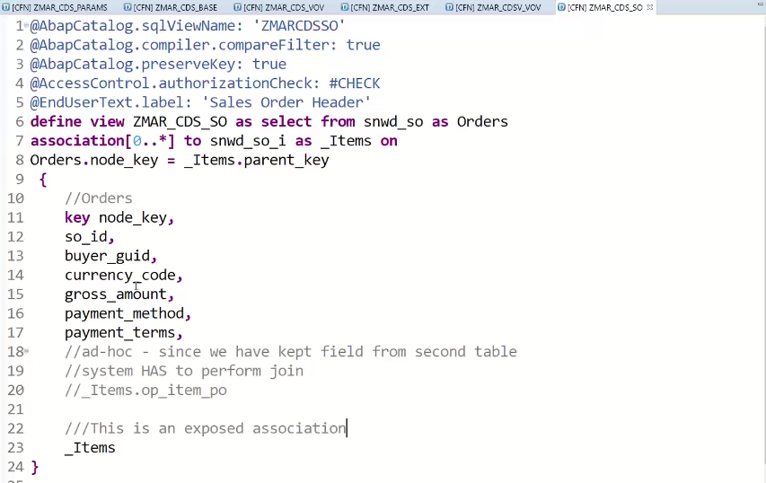
CDS Associations
Associations define relationships between entities in the data model
Association definition contains
Target entity with optional alias (Recommended to start with _)
Cardinality[min .. max] (optional)
ON condition represents JOIN condition → easy to refactor
Consumption of Association
From
Projection list
Aggregations
WHERE, GROUP BY and HAVING clauses
Path Expressions Support
Simplified consumption both in CDS view and Open SQL
Filter Expressions Support

Slide 16

CDS Associations : Advantages
Why would you use associations?
Easy model consumption
Path expressions
Filter expressions
Small(er) re-use views
“JOINs on demand”: JOINs are only generated if the corresponding association is consumed

Slide 17



Virtual Data Model ( VDM )
Customers and Partners can develop on released VDM views
VDM is the data model and source for all types of applications
Transactional
Analytical
External interfaces
VDM is a set of views on SAP S/4HANA application data
Business-oriented
Understandable & semantically rich
Reusable & stable
Executed on SAP HANA
Implemented as ABAP CDS views (core data services)
R
R
R
Virtual Data Model (CDS)
SalesOrder
Customer
SalesOrderItem
Material
HANA Platform
SAP S/4HANA Core Tables (ECC)
>40 000 Tables (technical, cryptic, unrelated)

Slide 18
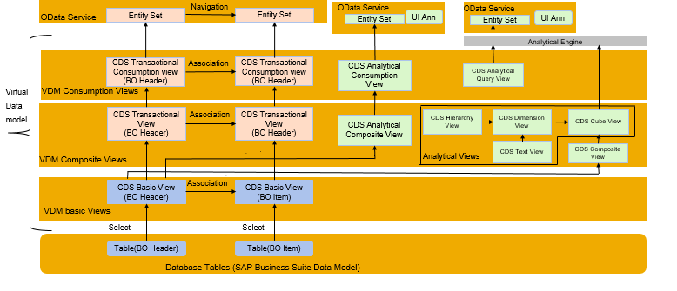
VDM Layering Architecture

Slide 19




Type’s of VDM View
All types of consumers
VDM Consumption Views C_*
VDM External API Views A_*
Purpose-built for apps and APIs
VDM Composite Interface Views I_*
Convenience and special views for reuse
VDM Basic Interface Views I_*
Basic VDM for reuse
Application Data (Tables)
Cryptic, invisible

Slide 20
When to Use which Annotation
@OData
Fiori Application
@Analytic
Analytics
CDS Views
@ObjectModel
@UI
Transactional App
@AnalyticDetails
@DefaultAgg
S/4HANA Embedded Analytics
SAP Analytics Cloud
@Semantic
Normal ABAP Report

Slide 21
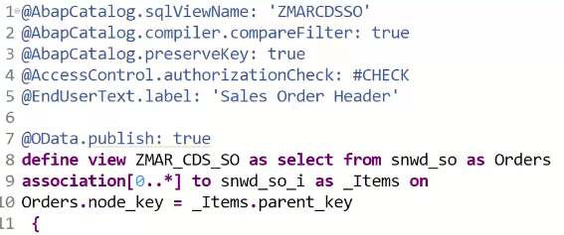
Create ODATA on top of CDS
Add an annotation called @Odata.publish: true
Hover the mouse on warning sign and copy the name of the service
Go to SAP system using Ctrl + 6 and tcode : /n/IWFND/MAINT_SERVICE
Click on add service
Enter LOCAL and Service name we copies in step 2
Hit Enter
Select and choose ADD Service
Choose package and TR
Come back to CDS navigator view and double click on ODATA node
Enter ABAP credentials and test the service.
https://help.sap.com/doc/abapdocu_751_index_htm/7.51/en-US/index.htm?file=abencds_annotations.htm
https://help.sap.com/viewer/8308e6d301d54584a33cd04a9861bc52/2020.000/en-US/8573b810511948c8a99c0672abc159aa.html
OData exposure

Slide 22
Feedback
AnubhavTrainings.com :
https://www.anubhavtrainings.com

Slide 23
End of Day 6

Slide 24

Questions

Slide 25

Anubhav Oberoy

